Slide 1




GRADE 10 · ALGEBRA II · TOPIC 2
Lesson 2-5
Completing
the Square
Journey of 6 stations, 60 minutes
Quadratic Functions and Equations
Mr Malek Thiab
FAITH, RIGHTEOUSNESS AND WISDOM
Notes:
Speaker notes: Welcome to Lesson 2-5: Completing the Square.
Timing: 60 minutes (Diagnose 6, Targeted Instruction 18, Practice 12, Production 12, Mastery Gate 6, Smart Production 6). For a 40-minute class scale every station by two thirds.
The journey map on the next slide shows the six stations; in slideshow mode the Morph transition zooms the station circles into the breadcrumb at the top of every later slide.

Slide 2


Today's journey
Six stations. Each one zooms in as we arrive.
Targeted Instruction
18 min
Production
12 min
Smart Production
6 min
2
4
6
1
3
5
Diagnose
6 min
Practice
12 min
Mastery Gate
6 min
FAITH, RIGHTEOUSNESS AND WISDOM
Notes:
Speaker notes: This is the whole map. Walk it left to right: Diagnose (what we already know), Targeted Instruction (Perfect squares and the adjustment term; Solve by completing the square; When the coefficient of x squared is not 1; Maximum and minimum values), Practice (Practice, Apply, Investigate), Production (the Jeddah Corniche water jet), Mastery Gate (three questions to pass), Smart Production (create, then Time to Check).
In slideshow mode the Morph transition animates these circles shrinking into the breadcrumb on later slides; without Morph the slides fade.
Ask the class which station they think will be hardest.

Slide 3
What we are learning
OBJECTIVES
VOCABULARY
Rewrite a quadratic equation into the form (x − p)² = q by completing the square.
Determine the minimum or maximum value of a quadratic function using completing the square.
Solve real-world problems modeled by quadratic equations using completing the square.
adjustment term
completing the square
HSN.CN.C.7 · HSA.SSE.B.3.B · HSA.REI.B.4.A · HSA.REI.B.4.B · HSF.LE.B.6 · HSF.IF.C.8.A
FAITH, RIGHTEOUSNESS AND WISDOM
Mr Malek Thiab · 3
Notes:
Speaker notes: Read the objectives aloud one at a time and have students say which one they feel least sure about.
Vocabulary used today: adjustment term, completing the square.
Standards are on the next slide.
The essential question and mathematical practices are not shown because they are not in the project documents; add them from the curriculum map if you want them displayed.

Slide 4
Standards
HSN.CN.C.7 Solve quadratic equations with real coefficients that have complex solutions.
HSA.SSE.B.3.B Complete the square in a quadratic expression to reveal the maximum or minimum value of the function it defines.
HSA.REI.B.4.A Use the method of completing the square to transform any quadratic equation in x into an equation of the form (x - p)2 = q that has the same solutions. Derive the quadratic formula from this form.
HSA.REI.B.4.B Solve quadratic equations by inspection (e.g., for x2 = 49), taking square roots, completing the square, the quadratic formula and factoring, as appropriate to the initial form of the equation. Recognize when the quadratic formula gives complex solutions and write them as a ± bi for real numbers a and b.
HSF.LE.B.6 Apply quadratic functions to physical problems, such as the motion of an object under the force of gravity.
HSF.IF.C.8.A Use the process of factoring and completing the square in a quadratic function to show zeros, extreme values, and symmetry of the graph, and interpret these in terms of a context.
HSN.CN.C.7 · HSA.SSE.B.3.B · HSA.REI.B.4.A · HSA.REI.B.4.B · HSF.LE.B.6 · HSF.IF.C.8.A
FAITH, RIGHTEOUSNESS AND WISDOM
Mr Malek Thiab · 4
Notes:
Speaker notes: Standards are quoted verbatim from the curriculum map. Students do not need to read them aloud; point to the ones that match today's objectives.

Slide 5
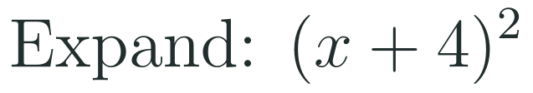

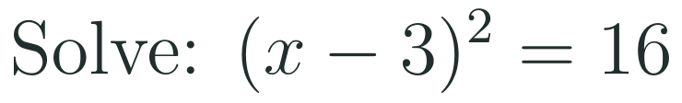
1
2
3
4
5
6
STATION 1 · DIAGNOSE · 6 MIN
Start here: three quick checks
1
2
3
Done when
All three answers are written without a calculator, and you can say why Question 3 has two solutions.
HSN.CN.C.7 · HSA.SSE.B.3.B · HSA.REI.B.4.A · HSA.REI.B.4.B · HSF.LE.B.6 · HSF.IF.C.8.A
FAITH, RIGHTEOUSNESS AND WISDOM
Mr Malek Thiab · 5
Notes:
Speaker notes (Diagnose, 6 min, no calculator):
Answers. Q1: (x+4)^2 = x^2 + 8x + 16 (the middle term is 2 x 4 x x = 8x, and the last term is 4^2 = 16). Q2: x^2 + 10x + 25 = (x+5)^2 because 5 x 2 = 10 and 5^2 = 25. Q3: take the square root of both sides: x - 3 = 4 or x - 3 = -4, so x = 7 or x = -1. Verbal misconceptions: Q1 students write x^2 + 16 (the middle term forgotten); Q2 students write (x+10)^2 or (x+25)^2 (the middle number is double the number in the bracket); Q3 students give only x = 7 (forgetting the minus root). Adaptive routing: if >30% miss Q1, rehearse expanding a squared bracket for 2 minutes, then go to slide 7 / block 1; if >30% miss Q2, work two more perfect-square factorings before slide 7 / block 1; if >30% miss Q3, practise square roots with plus and minus before slide 8 / block 2. If all three are secure, move quickly through slide 7 and start the Investigate route early.

Slide 6


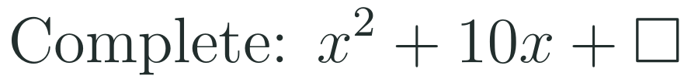
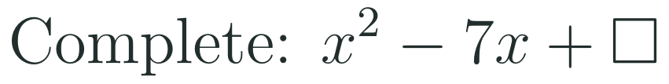
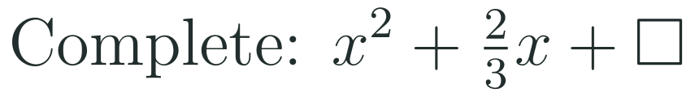
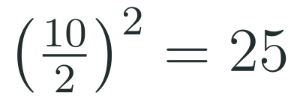
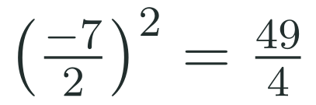
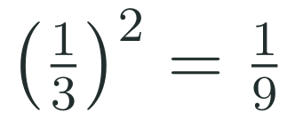
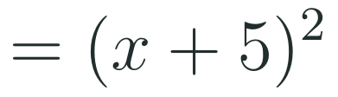
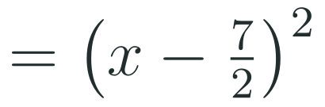
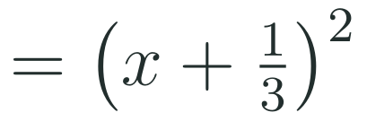
1
2
3
4
5
6
STATION 2 · TARGETED INSTRUCTION · 18 MIN
Perfect squares and the adjustment term
EXAMPLE A
EXAMPLE B
EXAMPLE C
HSN.CN.C.7 · HSA.SSE.B.3.B · HSA.REI.B.4.A · HSA.REI.B.4.B · HSF.LE.B.6 · HSF.IF.C.8.A
FAITH, RIGHTEOUSNESS AND WISDOM
Mr Malek Thiab · 6
Notes:
Speaker notes (Targeted Instruction, block 1 of 4):
Worked solutions. The adjustment term is the number that makes x^2 + bx a perfect square: take half of b and square it. Example 1: b = 10, half is 5, square is 25, so x^2 + 10x + 25 = (x+5)^2. Example 2: b = -7, half is -7/2, square is 49/4, so x^2 - 7x + 49/4 = (x - 7/2)^2 (the sign inside the bracket matches the sign of b). Example 3: b = 2/3, half is 1/3, square is 1/9, so x^2 + (2/3)x + 1/9 = (x + 1/3)^2. Check each by expanding: (x - 7/2)^2 = x^2 - 7x + 49/4. Verbal misconceptions: (1) students square b instead of half of b (25 vs 100 for b = 10); (2) students forget to halve first: 10^2 = 100; (3) with a negative b, the bracket is (x - ...), not (x + ...); (4) the adjustment term is not 'b over 2' - it is the SQUARE of b over 2. Adaptive routing: if >30% answer 100 for Example 1 on whiteboards, repeat with x^2 + 6x (half is 3, square is 9); if >30% miss Q1 of the Mastery Gate, come back to this slide (slide 7 / block 1).

Slide 7




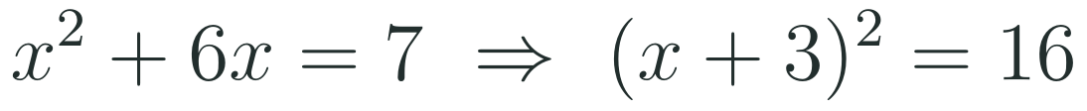
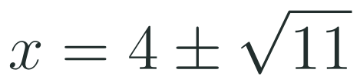
1
2
3
4
5
6
STATION 2 · TARGETED INSTRUCTION · 18 MIN
Solve by completing the square
EXAMPLE A
EXAMPLE B
EXAMPLE C
HSN.CN.C.7 · HSA.SSE.B.3.B · HSA.REI.B.4.A · HSA.REI.B.4.B · HSF.LE.B.6 · HSF.IF.C.8.A
FAITH, RIGHTEOUSNESS AND WISDOM
Mr Malek Thiab · 7
Notes:
Speaker notes (Targeted Instruction, block 2 of 4):
Worked solutions. Move the constant to the right, add the adjustment term to BOTH sides, factor the left side as a perfect square, then take square roots. Example 1: x^2 + 6x = 7; half of 6 is 3, square is 9; (x+3)^2 = 7 + 9 = 16; x + 3 = 4 or -4; x = 1 or x = -7. Check x = 1: 1 + 6 - 7 = 0. Example 2: x^2 - 8x = -5; half of -8 is -4, square is 16; (x-4)^2 = -5 + 16 = 11; x = 4 + sqrt(11) or 4 - sqrt(11) (about 7.32 and 0.68). Example 3: x^2 + 4x = -13; add 4: (x+2)^2 = -9; sqrt(-9) = 3i; x = -2 + 3i or -2 - 3i (a pair of complex conjugates - this connects to Lesson 2-4). Verbal misconceptions: (1) adding the adjustment term to only one side; (2) in Example 1 writing (x+3)^2 = 7 instead of 16; (3) forgetting the plus-or-minus when taking the square root; (4) writing x - 3 instead of x + 3 in the bracket; (5) stopping at (x+2)^2 = -9 and saying 'no solution' - there are no REAL solutions, but there are two complex ones. Adaptive routing: if >30% write (x+3)^2 = 7 for Example 1, show the balance idea - whatever is added on the left must be added on the right - and redo with x^2 + 4x = 5; if >30% miss Q2 of the Mastery Gate, come back to this slide (slide 8 / block 2).

Slide 8


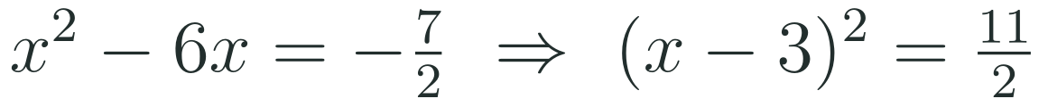
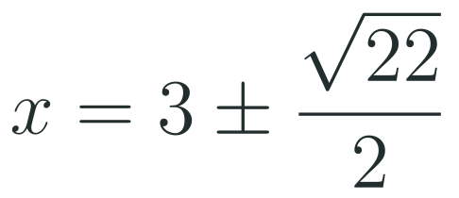

1
2
3
4
5
6
STATION 2 · TARGETED INSTRUCTION · 18 MIN
When the coefficient of x squared is not 1
EXAMPLE A
EXAMPLE B
HSN.CN.C.7 · HSA.SSE.B.3.B · HSA.REI.B.4.A · HSA.REI.B.4.B · HSF.LE.B.6 · HSF.IF.C.8.A
FAITH, RIGHTEOUSNESS AND WISDOM
Mr Malek Thiab · 8
Notes:
Speaker notes (Targeted Instruction, block 3 of 4):
Worked solutions. First divide EVERY term by the leading coefficient so that the x^2 term has coefficient 1. Example 1: 2x^2 - 12x + 7 = 0 becomes x^2 - 6x + 7/2 = 0, so x^2 - 6x = -7/2; add 9: (x-3)^2 = -7/2 + 9 = 11/2; x - 3 = +/- sqrt(11/2) = +/- sqrt(22)/2 (multiply top and bottom by sqrt 2); x = 3 +/- sqrt(22)/2, about 5.35 and 0.65. Example 2: divide by 3: x^2 + 4x + 5 = 0; x^2 + 4x = -5; add 4: (x+2)^2 = -1; x = -2 +/- i. Verbal misconceptions: (1) dividing only the x^2 term, or only the first two terms, by a; (2) adding (b/2)^2 using the original b instead of the new one after dividing; (3) leaving the root as sqrt(11/2) without noticing it can be rationalised; (4) forgetting that the right side changes when 9 is added: -7/2 + 9 = 11/2, not 2. Adaptive routing: if >30% miss the first step of Example 1, restate: 'the bracket method needs a coefficient of 1'; if >30% miss Q2 of the Mastery Gate, come back to this slide (slide 9 / block 3).

Slide 9
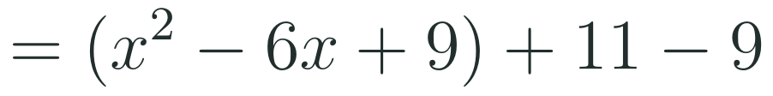
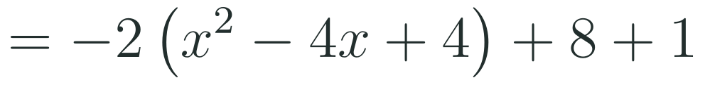
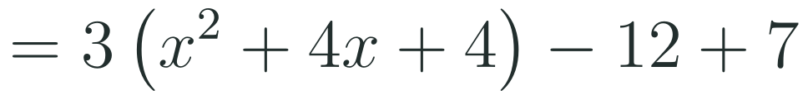
1
2
3
4
5
6
STATION 2 · TARGETED INSTRUCTION · 18 MIN
Maximum and minimum values
EXAMPLE A
EXAMPLE B
EXAMPLE C
HSN.CN.C.7 · HSA.SSE.B.3.B · HSA.REI.B.4.A · HSA.REI.B.4.B · HSF.LE.B.6 · HSF.IF.C.8.A
FAITH, RIGHTEOUSNESS AND WISDOM
Mr Malek Thiab · 9
Notes:
Speaker notes (Targeted Instruction, block 4 of 4):
Worked solutions. Complete the square on the expression to reach vertex form; the number outside the bracket is the extreme value k, reached at x = h. Example 1: x^2 - 6x + 11 = (x^2 - 6x + 9) + 11 - 9 = (x-3)^2 + 2; a = 1 is positive so this is a minimum, 2, at x = 3. Example 2: -2x^2 + 8x + 1 = -2(x^2 - 4x) + 1 = -2(x^2 - 4x + 4) + 8 + 1 (because -2 x -4 = +8 compensates) = -2(x-2)^2 + 9; a = -2 is negative so this is a maximum, 9, at x = 2. Example 3: 3x^2 + 12x + 7 = 3(x^2 + 4x + 4) - 12 + 7 = 3(x+2)^2 - 5; minimum -5 at x = -2. Verbal misconceptions: (1) when a is not 1, students add 4 inside the bracket but forget it is multiplied by a, so the compensation is 3 x 4 = 12, not 4; (2) the extreme VALUE is k, not h (the value is -5, not -2); (3) the x-value where it happens is h with the opposite sign to the bracket: (x+2) means x = -2. Adaptive routing: if >30% give the compensation as 4 in Example 3, redraw the step: '3 times the 4 you added inside'; if >30% miss Q3 of the Mastery Gate, come back to this slide (slide 10 / block 4).

Slide 10
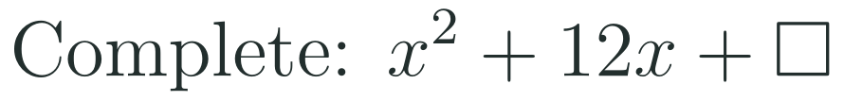



1
2
3
4
5
6
STATION 3 · PRACTICE · 12 MIN
Give it a go: Practice, Apply, Investigate
PRACTICE
APPLY
INVESTIGATE
Secure the method
Use it in context
Find out why
Done when: the adjustment term is added to both sides and both solutions are checked by substitution.
Done when: you divide by the leading coefficient first, write the vertex or the solutions in exact form, and say where the minimum occurs.
Done when: your argument keeps the equation balanced at every step, and the second item ends with the quadratic formula.
HSN.CN.C.7 · HSA.SSE.B.3.B · HSA.REI.B.4.A · HSA.REI.B.4.B · HSF.LE.B.6 · HSF.IF.C.8.A
FAITH, RIGHTEOUSNESS AND WISDOM
Mr Malek Thiab · 10
Notes:
Speaker notes (Practice, 12 min; tierless differentiation: students choose the starting column and may move across):
Answers. Practice 1: half of 12 is 6, square is 36: x^2 + 12x + 36 = (x+6)^2. Practice 2: x^2 - 6x = 16; add 9: (x-3)^2 = 25; x = 3 +/- 5 = 8 or -2. Check x = 8: 64 - 48 - 16 = 0. Apply 1: divide by 2: x^2 + 4x = 5/2; add 4: (x+2)^2 = 13/2; x = -2 +/- sqrt(13/2) = -2 +/- sqrt(26)/2 (about 0.55 and -4.55). Apply 2: x^2 + 8x + 3 = (x+4)^2 - 16 + 3 = (x+4)^2 - 13; minimum -13 at x = -4. Investigate 1: the equation is a balance - adding the same number to both sides keeps the solutions the same; adding it to one side changes the equation. Investigate 2: divide by a: x^2 + (b/a)x = -c/a; add (b/2a)^2: (x + b/2a)^2 = (b^2 - 4ac)/(4a^2); x + b/2a = +/- sqrt(b^2 - 4ac)/2a; x = (-b +/- sqrt(b^2 - 4ac))/2a. Verbal misconceptions: students add the term to one side only, forget to halve, or forget to divide by a first. Adaptive routing: if most students finish Practice quickly, move them to Apply; students who select Investigate may need the hint 'the left side must become a perfect square'.

Slide 11

1
2
3
4
5
6
STATION 4 · PRODUCTION · 12 MIN
Production: the Jeddah Corniche water jet
THE MODEL
DONE WHEN
On the Jeddah Corniche, a Red Sea waterfront project that supports Vision 2030 tourism, engineers programme a decorative water jet. The model height of one jet above the sea surface is h(t) = −5t² + 30t + 2 metres, where t is the time in seconds after it leaves the nozzle. These are model values, not real measurements.
Task 1 shows the factor −5 taken out and the adjustment term balanced, giving a maximum of 47 metres at 3 seconds.
Task 2 gives two times that are the same distance either side of the time of the maximum.
Task 3 gives only the positive time and rejects the negative root with a reason.
Every answer is written in a full sentence with units and states that the numbers are model values.
Complete the square to write h in the form a(t − p)² + q, and state the greatest height and the time it happens.
Find the two times at which the jet is at a height of 42 metres.
Find the time at which the jet reaches sea level, to the nearest hundredth of a second.
Hint for solving: after taking out −5, add 9 inside the bracket and subtract 5 times 9 outside to keep the expression equal.
HSN.CN.C.7 · HSA.SSE.B.3.B · HSA.REI.B.4.A · HSA.REI.B.4.B · HSF.LE.B.6 · HSF.IF.C.8.A
FAITH, RIGHTEOUSNESS AND WISDOM
Mr Malek Thiab · 11
Notes:
Speaker notes (Production, 12 min):
Model values only. Task 1: h = -5(t^2 - 6t) + 2 = -5(t^2 - 6t + 9) + 45 + 2 = -5(t - 3)^2 + 47. Maximum height 47 m at t = 3 s. Task 2: -5(t-3)^2 + 47 = 42 gives (t-3)^2 = 1, so t - 3 = +/- 1, t = 2 s or t = 4 s (symmetric about t = 3). Task 3: h = 0 gives -5(t-3)^2 = -47, (t-3)^2 = 47/5 = 9.4, t - 3 = +/- 3.066, t = 6.07 s (the other root, -0.07 s, is before the jet leaves the nozzle, so it is rejected). Verbal misconceptions: students compensate by subtracting 9 instead of 45; they report 3 as the maximum height instead of the time; they keep both roots in Task 3. Adaptive routing: if most groups cannot take out -5 in Task 1, return to slide 10 / block 4 Example 2; groups that finish early can find when the jet is above 30 metres.

Slide 12
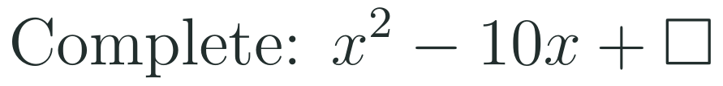

1
2
3
4
5
6
STATION 5 · MASTERY GATE · 6 MIN
Mastery Gate: three questions to pass
1
2
3
Pass mark
3 of 3 correct unlocks Station 6. Fewer than that: return to the slide for the question you missed, redo it, then re-take the gate.
HSN.CN.C.7 · HSA.SSE.B.3.B · HSA.REI.B.4.A · HSA.REI.B.4.B · HSF.LE.B.6 · HSF.IF.C.8.A
FAITH, RIGHTEOUSNESS AND WISDOM
Mr Malek Thiab · 12
Notes:
Speaker notes (Mastery Gate, 6 min, no calculator):
Answers. Q1: half of -10 is -5, square is 25: x^2 - 10x + 25 = (x-5)^2. Q2: x^2 + 8x = 9; add 16: (x+4)^2 = 25; x + 4 = +/- 5; x = 1 or x = -9. Q3: x^2 + 6x + 4 = (x+3)^2 - 9 + 4 = (x+3)^2 - 5; minimum -5 at x = -3. Verbal misconceptions: Q1 students write 100 or -25; Q2 students write (x+4)^2 = 9 (adding to one side only); Q3 students answer -3 (the x-value, not the minimum value). Adaptive routing: students who miss Q1 return to slide 7 / block 1; Q2, slide 8 / block 2; Q3, slide 10 / block 4. Students who score 3 out of 3 move to Smart Production.

Slide 13

1
2
3
4
5
6
STATION 6 · SMART PRODUCTION · 6 MIN
Smart Production: make one, then check it
CREATE
TIME TO CHECK
Choose two numbers p and q and write the equation (x − p)² = q, then expand it to the form x² + bx + c = 0.
Swap with a partner and solve each other's equation by completing the square.
Check one solution by substitution and say why q decides whether the solutions are real or complex.
Exit ticket: write your answer on a sticky note and place it on the door.
Done when: both equations are solved correctly, the check is written, and you can explain the sign of q.
Next lesson: 2-6 The Quadratic Formula.
HSN.CN.C.7 · HSA.SSE.B.3.B · HSA.REI.B.4.A · HSA.REI.B.4.B · HSF.LE.B.6 · HSF.IF.C.8.A
FAITH, RIGHTEOUSNESS AND WISDOM
Mr Malek Thiab · 13
Notes:
Speaker notes (Smart Production, 6 min):
Exit ticket solution. x^2 - 4x = 12; add 4: (x-2)^2 = 16; x - 2 = +/- 4; x = 6 or x = -2. Check x = 6: 36 - 24 - 12 = 0. Create task: for example p = 2 and q = 5 gives x^2 - 4x - 1 = 0 and x = 2 +/- sqrt(5); if q is negative the solutions are complex. Verbal misconception: students think a negative q means 'no solution'. Adaptive routing: collect the sticky notes and sort into correct, sign error and one-side-only; start the next lesson with the most common error.

Slide 14
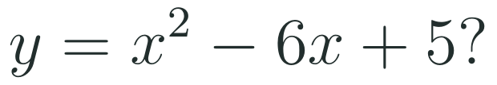
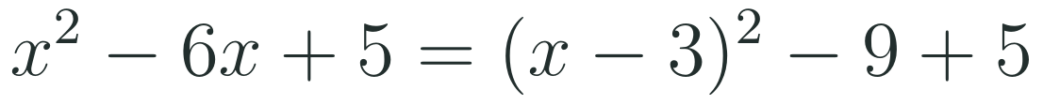
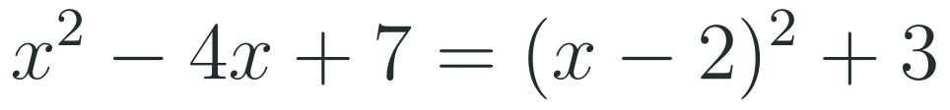
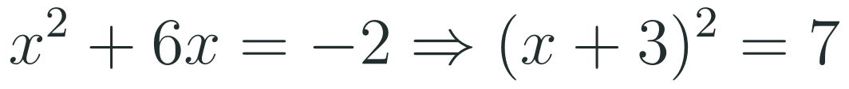
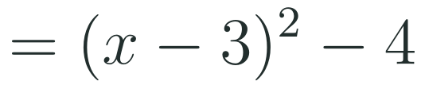

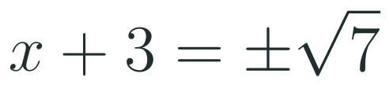


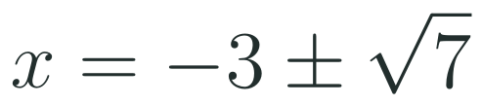
Exam connections
SAT
GAT
SAAT
STEPS
STEPS
STEPS
1
1
1
2
2
2
3
3
3
HSN.CN.C.7 · HSA.SSE.B.3.B · HSA.REI.B.4.A · HSA.REI.B.4.B · HSF.LE.B.6 · HSF.IF.C.8.A
FAITH, RIGHTEOUSNESS AND WISDOM
Mr Malek Thiab · 14
Notes:
Speaker notes: each exam item is worked in numbered steps.
SAT (Advanced Math, grid-in or four options): rewrite in vertex form; the constant after completing the square is the minimum value, -4 (the trap answer 3 is the x-coordinate; -9 forgets to add 5). GAT / Qudurat (quantitative comparison): the minimum of A is 3 at x = 2, which is greater than B = 2 (trap: picking the x-value 2 as the minimum). SAAT / Tahsili: x^2 + 6x = -2; adding 9 to both sides gives (x+3)^2 = 7, so x = -3 +/- sqrt(7) (trap: (x+3)^2 = -2 + 3 = 1 from adding half of b instead of its square). Verbal reminders: always add (b/2)^2 to both sides.

Slide 15
Journey complete
Targeted Instruction
Production
Smart Production
✓
✓
✓
✓
✓
✓
Diagnose
Practice
Mastery Gate
Completing the square adds the adjustment term (b over 2) squared to both sides to make a perfect square, which solves any quadratic and reveals its maximum or minimum.
FAITH, RIGHTEOUSNESS AND WISDOM
Notes:
Speaker notes: Every station is checked off. Recap in one sentence: Completing the square adds the adjustment term (b over 2) squared to both sides to make a perfect square, which solves any quadratic and reveals its maximum or minimum. Collect the Time to Check responses. Next lesson: 2-6 The Quadratic Formula.

